Slide 1

Application Container Apps
A first look

Slide 2
Vocabulary
CNCF: Cloud Native Computing Foundation an open-source foundation dedicated to making cloud-native computing universal and sustainable. https://www.cncf.io/
Dapr: event-driven runtime that makes it easy for any developer to build resilient, stateless and statefull applications for different languages and frameworks – CNCF incubator https://dapr.io/
Bicep: a declerative language to describe Azure resources so they can easily deployed https://aka.ms/bicep
Keda: Kubernetes event-driven autoscaling, scale your cluster based on a wide range of cloud services (Google, Amazon, Microsoft, … ) – CNCF member https://keda.sh/
Envoy: Proxy for ingress functionality and trafic splitting – CNCF member https://www.envoyproxy.io/
Notes:
Bicep: Terraform competitor of Microsoft itself – in a declarative language you can describe your Azure resources – when deploying it translates the yaml files to ARM templates and these templates are deployed.
Dapr: in 2022 I’ll create a specific Dapr overview

Slide 3
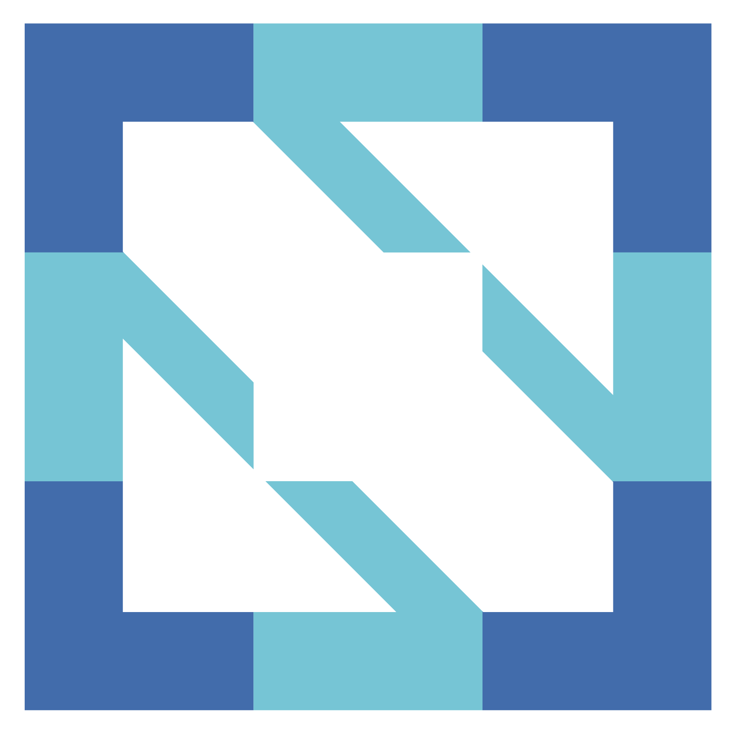
CNCF
CNCF is an open source software foundation dedicated to making cloud-native computing universal and sustainable.
Vendor neutral home for the fastest growing open source projects
Quality label: project is maintained, is focused on projects that have proven so solve problems
Complete landscape https://landscape.cncf.io/

Slide 4

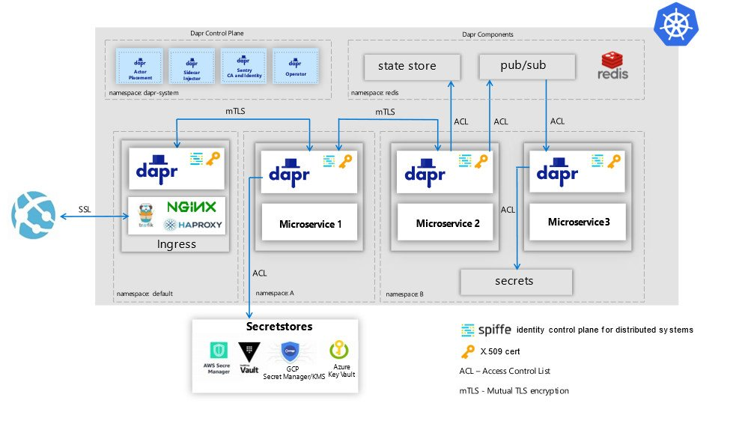
Dapr
Distributed Application Runtime provides API’s that simplify microservice connectivity
Building blocks, to tackle challenges like:
Service discovery
Message broker
Encryption
Observability
Secret management

Slide 5
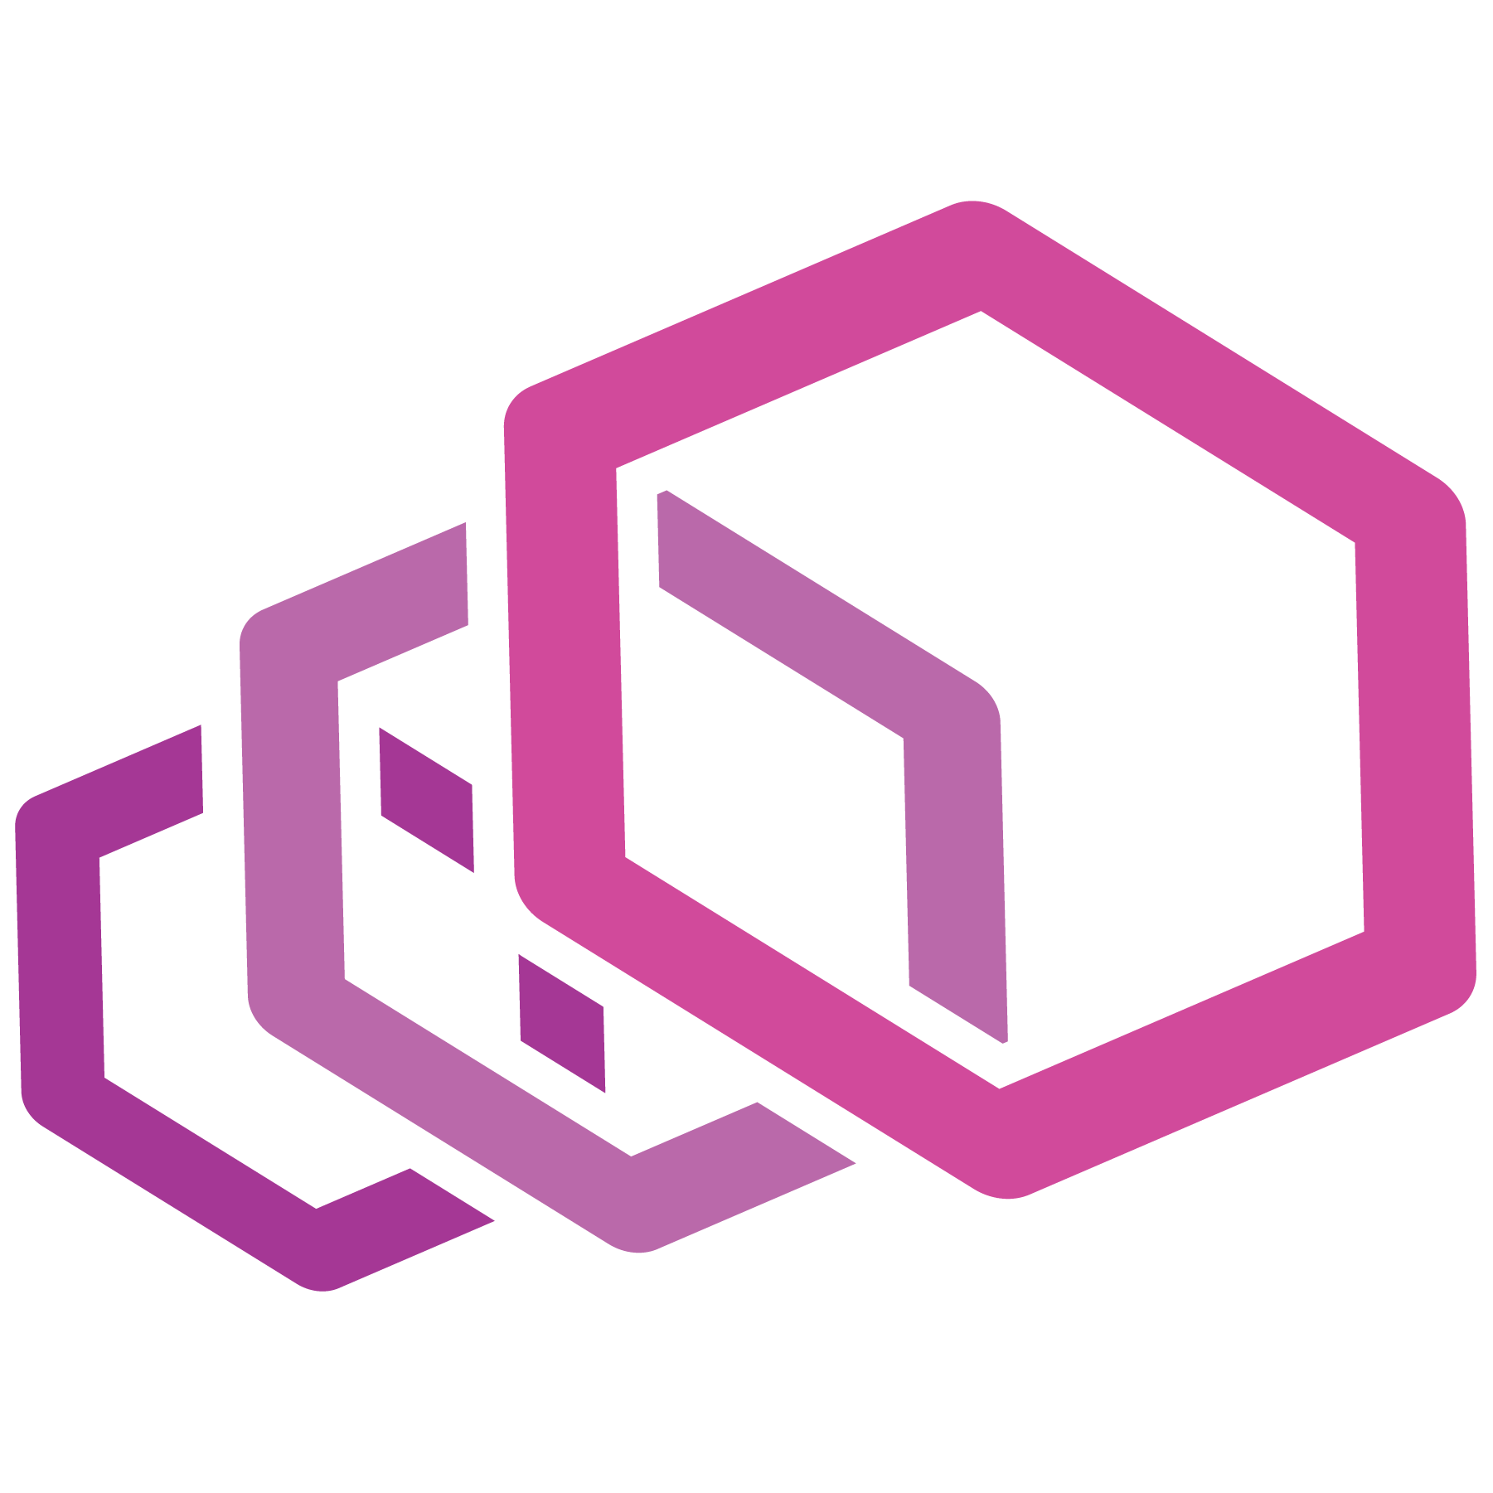
EnVOY
Is a proxy and communication bus designed for large modern service oriented architectures
Self-contained process that runs along the application server
With features like HTTP, TCP routing, filtering, HTTP/2 support, GRPC support, Service discovery, health checking, load balancing, observability, …
https://www.envoyproxy.io/docs/envoy/latest/intro/what_is_envoy

Slide 6
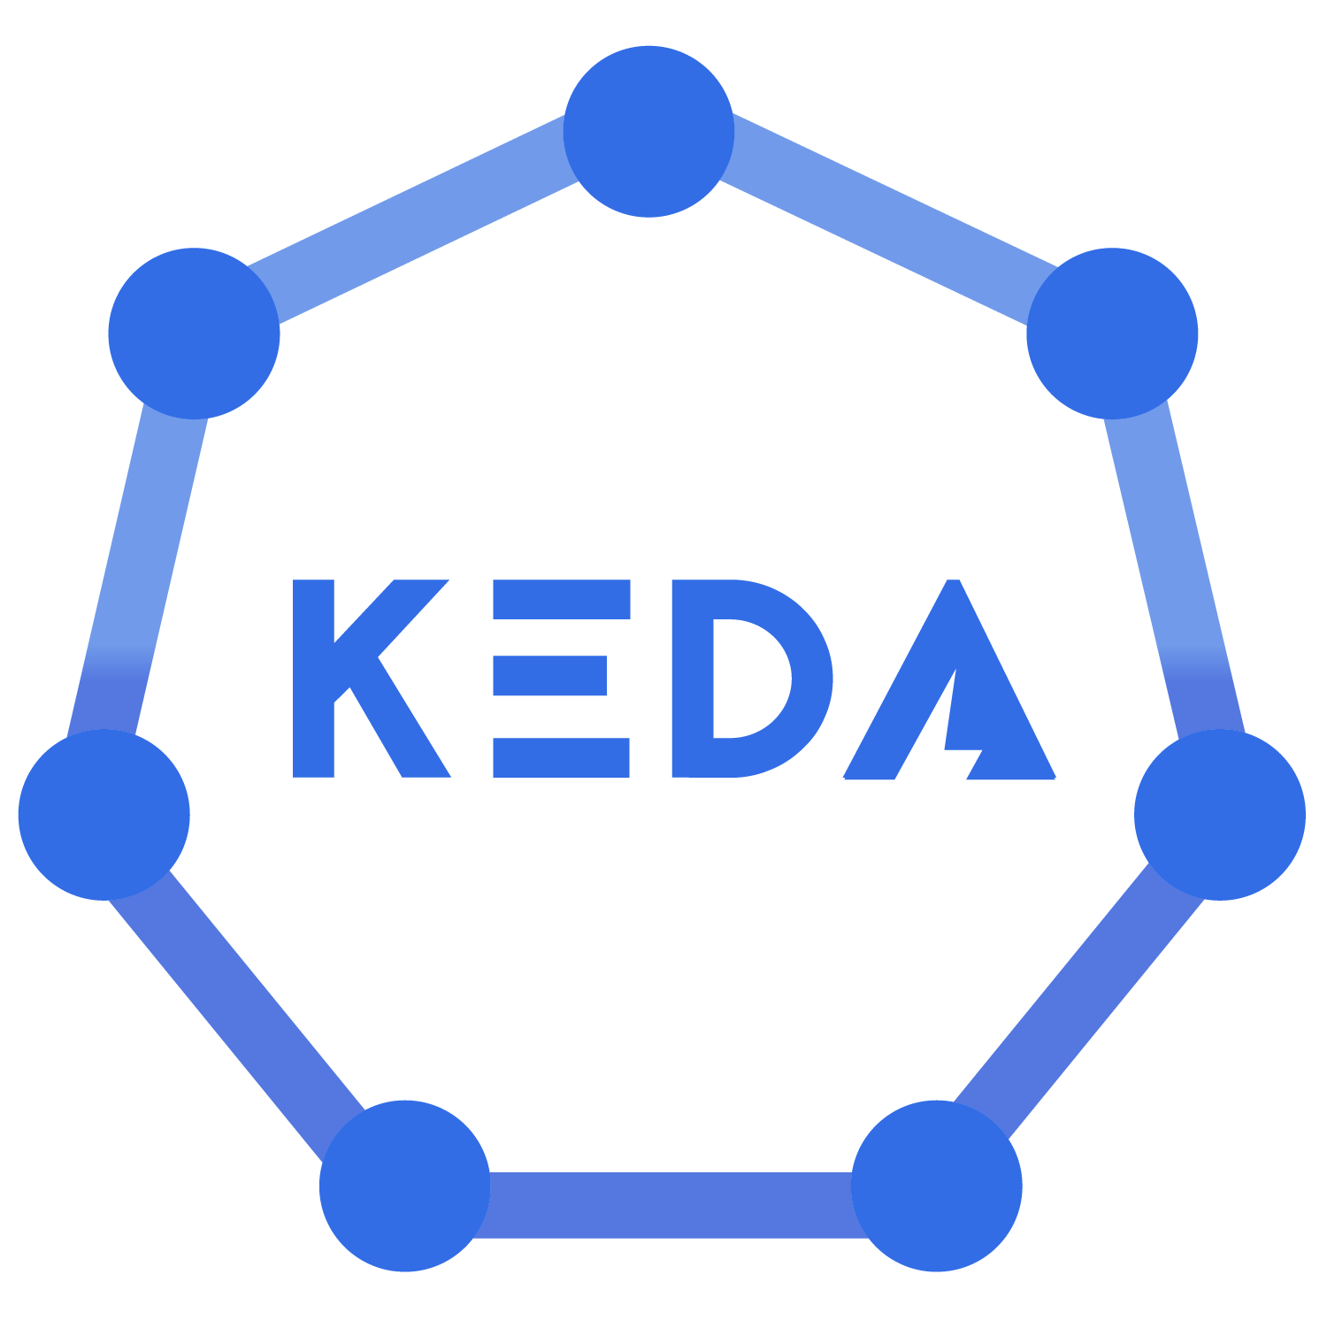
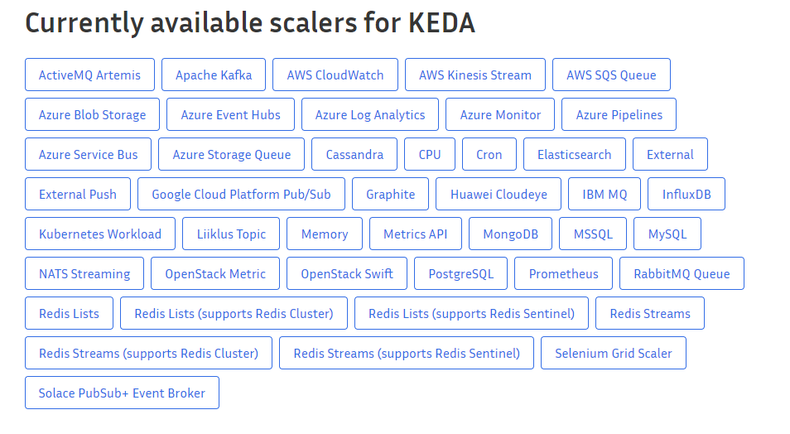
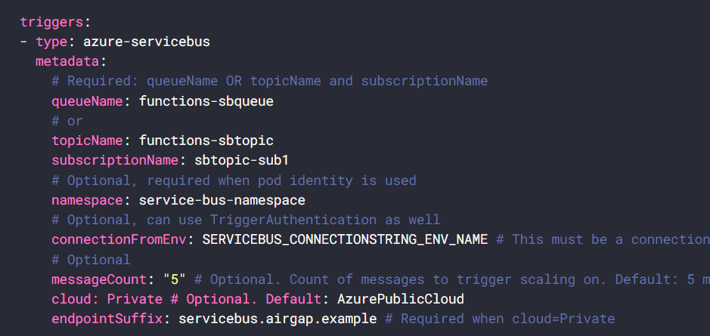
KEDA
Kubernetes based event-driven autoscaler
Based on cloud resources of different cloud vendors

Slide 7
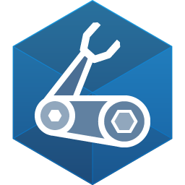
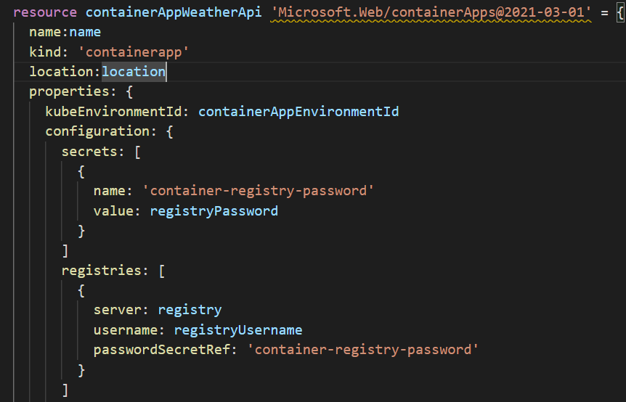
BICEP
Declarative language for Azure Resources
When compiled it’s translated to ARM templates
Even Beta features can be deployed with Bicep
Difference with Terraform
Single vendor (Microsoft)
No state

Slide 8
Where can you host docker containers?
On overview
Notes:
Note: you don’t need containers to build microservices.

Slide 9
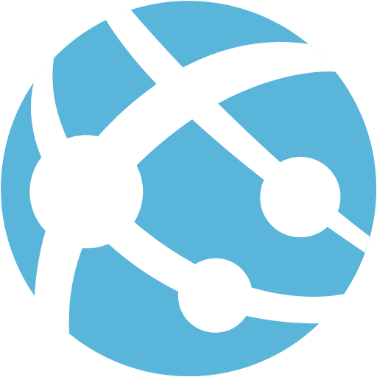

Apps
When hosting an API / website
Only http ingress
Basic A/B deployment (slots)
Certificate management, …
When hosting Event-driven code
Automatic scaling
Out of the box triggers (http, blob, servicebus, … )

Slide 10
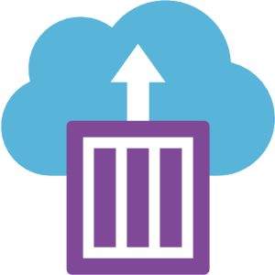
Azure container instances
Ideal for background processes.
you’ll need to manage everything yourself: Certificates, Load balancing, scaling

Slide 11
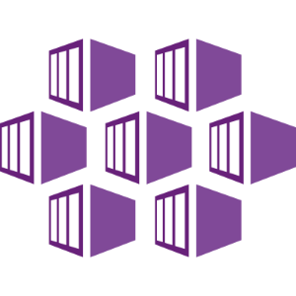
Azure Kubernetes service
Fully Managed Kubernetes cluster
Very simple deploy – even a one-liner
Microsoft will create the Infrastructure
But it’s only a platform
Notes:
Kubernetes is a container orchestrator
Serverless kubernetes, full access to the K8 api’s
Managed Kubernetes cluster –
kubernetes is infrastructure, 1 line of code –
but it’s only the platform but you still need to add and manage building blocks, proxy, scaling, … - steep learning curve - operational readyness
Those building blocks are donated by MS to the community KEDA, Dapr, Virtual Kubelet (run
For example to allow trafic into the cluster (load balancer, app gateway, how will we handle certificates)

Slide 12
Kubernetes – what do you need to bring to the table?
Network configuration
Identity Management
Data flow
Network
Secret management
Business continuity
Scalability
node availability
Operations
CI/CD
Health
Metrics & Cost managment
Building blocks: Dapr, Keda, Virtual Kubelet – donated to the community.

Slide 13
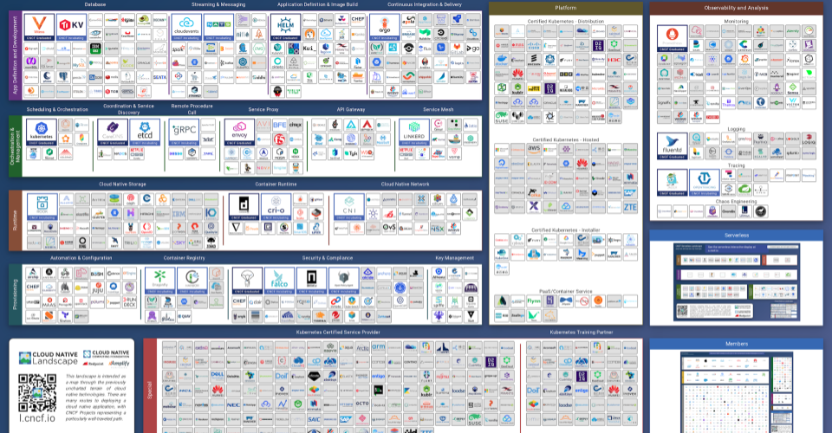
Notes:
There are quite a few choices
There is an amazing amount of power, but also quite some responsibility

Slide 14
What ARE Azure Container apps
Fully managed serverless container service
Build on AKS
Deploy API Endpoints
Hosting Background applications
Handling event-driven processing
Can scale to 0
Competitors: Google Cloud run, AWS app runner
Notes:
It’s not because you started with Azure Container apps – you can’t switch to AKS afterwards

Slide 15
What can it do?
Run multiple container revisions
Autscale (keda)
HTTP Ingress (envoy)
Split trafic
Internal ingress and service discovery
Dapr integration
Can run containers from any registry
Secret Management
Notes:
Focussed on building business functionality.

Slide 16
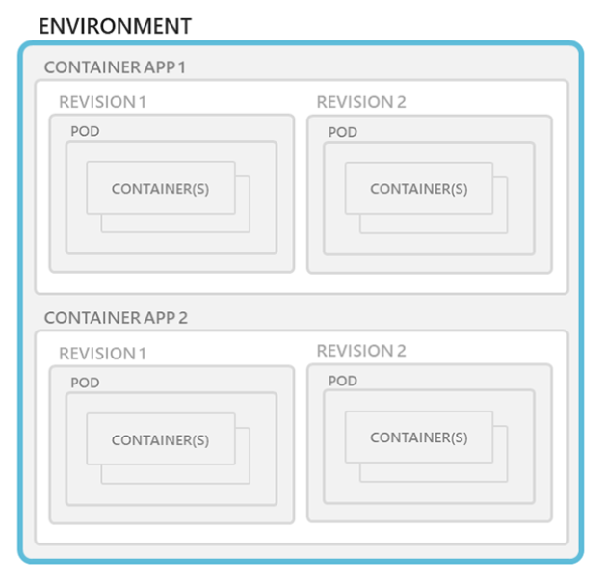
Architecture: Environments
Everything runs in an Environment – secure boundary around a group of apps (VNET)
Which can have one or more Apps(=Microservice)
Manage related services
Different apps on the same network
Deploy apps that need to communicate with each other
When created it has an unique domain:
graybeach-d4954b40.northeurope.azurecontainerapps.io
1 Log Analytics Workspace needed
Environments are free

Slide 17
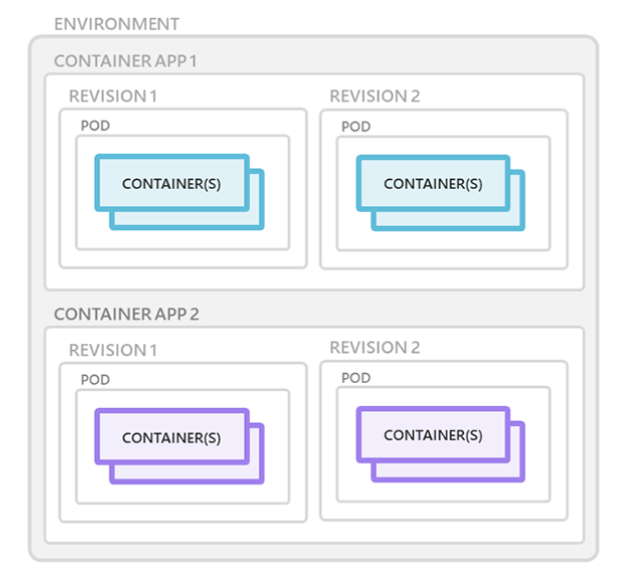
Architecture: Containers
Containers that use any runtime, programming language, or dev stack
Linux based containers
No requirement for base image
When a container crashes it restarts automatically
You can run mutiple containers in the same app (sidecar)
That group of containers is known as pods (K8)
Unique url for each app
acs-weather-api--gdyk2kr.graybeach-d4954b40.northeurope.azurecontainerapps.io

Slide 18
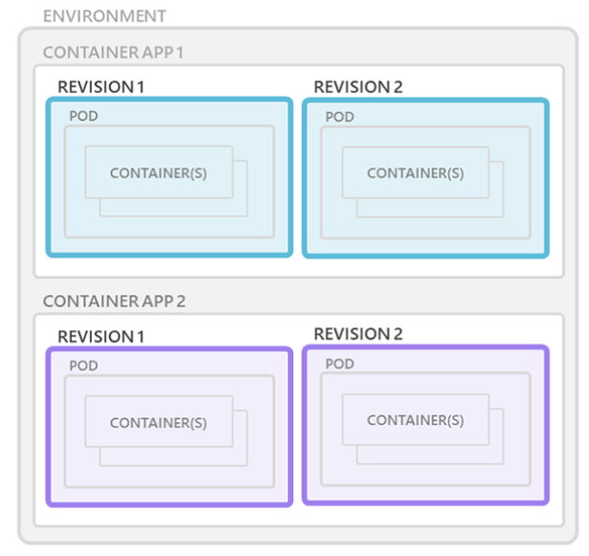
Architecture: Revisions
Revisions are version of your app
New revisions are created when a new image is deployed, App template changes (config)
Revisions are immutable
It can hold to up to 100 revisions

Slide 19
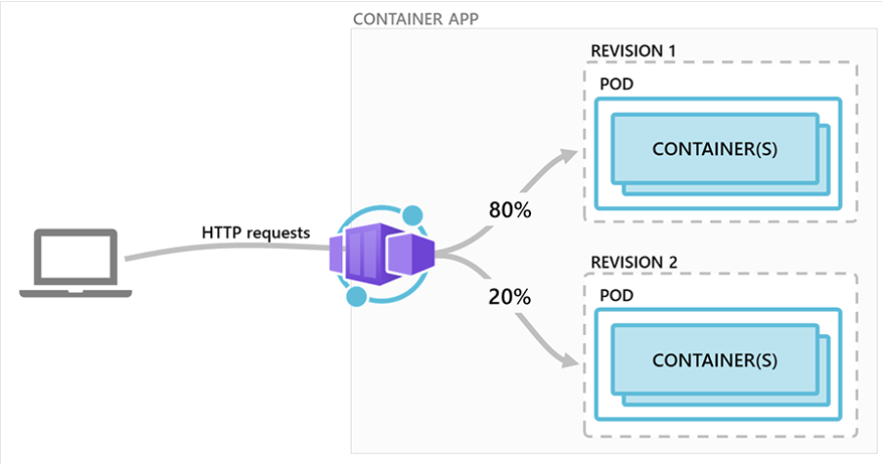
Architecture: Revisions
Can be used for A/B deployment or BlueGreen deployment
Revisions remain active until you deactivate them, or you can configure it to automatically deactivate
Inactive revisions are free
You can have 100 revisions until they are being purged

Slide 20
Demo time
Notes:
Demo 1– just the API
– already deployed
Show logging, show portal
Show revisions
Curl to the 1 revision,
- curl to api mgmt url
Demo 2
Build new image of the API
Show bicep code
Create new deployment
Track deployment
Showcase Blue / green
- Adapt revisions
Curl call
Demo 3
Deploy order processor
Focus on the keda rules
Send 500 messages to servicebus
Query number of instances
Show metrics of Servicebus

Slide 21
Limitations & Roadmap
In Beta and only available in North Europe & Canada Central
Monitoring stil not sufficient
It would be great to see even more CNCF integrations
Managed Identity, keyvault and existing VNET integration are announced and will be released in 2022
Run the Azure Functions Runtime in a container

Slide 22
Interesting resources
https://aka.ms/containerapps
https://www.thorsten-hans.com/
https://blog.baeke.info/
Twitter @jeffhollan

Slide 23
Questions?

